Slide 1

Searching
An agent with several immediate options of
unknown value can decide what to do by examining
different possible sequences of actions that leads to
the states of known value, and then choosing the
best sequence.
The process of looking for sequences
actions from the current state to reach the goal
state is called search.
The search algorithm takes a problem as input and returns a solution in the form of action sequence.

Slide 2
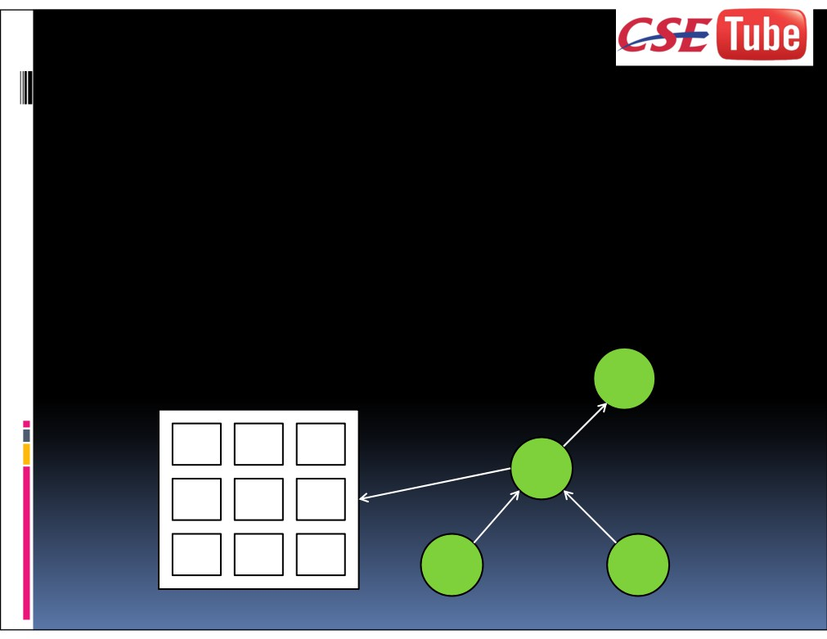
A state is a (representation of) a physical
configuration.
A node is a data structure constituting part of a
search tree includes parent, children, depth, path cost
g(x).
PARENT-NODE
5 4
Node
ACTION = right
DEPTH = 6
6 1 8
PATH-COST = 6
STATE
7 3 2
http://csetube.weebly.com/

Slide 3
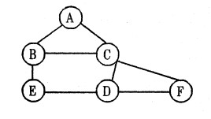
Tree Search algorithm
Task : Find a path to reach F from A
1. Start the sequence with the initial state and check whether it is a goal state or not.
a, If it is a goal state return success.
b. Otherwise perform the following sequence of steps
  From the initial state (current state) generate and expand the new set of states.
  The collection of nodes that have been generated but not expanded
  is called as fringe.
  Each element of the fringe is a leaf node, a node with no successors in the
  tree.

Slide 4

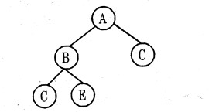
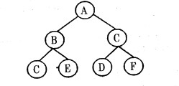
Expanding A
Expanding B
Expanding C
Sequence of steps to reach the goal state F from (A = A - C - F)

Slide 5
2. Search strategy: In the above example we did the sequence of choosing, testing and expanding until a solution is found or until there are no more states to be expanded. The choice of which state to expand first is determined by search strategy.
3. Search tree: The tree which is constructed for the search process over the state space.
4. Search node: The root of the search tree that is the initial state of the problem.

Slide 6
The general tree search algorithm
function
TREE – SEARCH (problem, strategy)
returns a solution, or failure
initialize the search tree using the initial state of problem
loop do
if
there are no candidates for expansion
then return
failure
choose a leaf node for expansion according to strategy
if
then return
the corresponding solution
the node contains a goal state
else
Expand the node and add the resulting nodes to the search tree

Slide 7
There are many ways to represent nodes, but we will assume that a node is a data structure with five components:
STATE: the state in the state space to which the node corresponds
PARENT-NODE: the node in the search tree that generated this node;
ACTION (RULE): the action that was applied to the parent to generate the node;
PATH-COST: the cost, traditionally denoted by g(n) , of the path from the initial state to the node.
DEPTH: the number of steps along the path from the initial state.

Slide 8
The queue operations are defined as:
MAKE-QUEUE(elements) - creates a queue with the given elements
EMPTY(queue)-returns true only if there are no more elements in the queue.
REM0VE-FIRST(queue) - removes the element at the front of the queue and returns it
INSERT ALL (elements, queue) - inserts set of elements into the queue and returns the resulting queue.
FIRST (queue) - returns the first element of the queue.
INSERT (element, queue) - inserts an element into the queue and returns the resulting queue.

Slide 9
The general tree search algorithm with queue representation.
function
returns a solution, or failure
TREE – SEARCH (problem, fringe)
fringe
INSERT (MAKE – NODE ( INITIAL _ STATE [problem]), fringe)
<-
loop do
then return
REMOVE – FIRST (fringe)
EMPTY? (fringe)
failure
node
<-
if
if
GOAL - TEST [problem] applied to (STATE [ node]) succeeds
then return
SOLUTION (node)
fringe
<-
INSERT – ALL (EXPAND (node, problem), fringe)

Slide 10
function
EXPAND (node, problem)
returns a set of nodes
successors
the empty set
<-
For each
<action, result>
in
do
SUCCESSORS – FN [problem] (STATE [node])
S
<-
a new NODE
STATE[s]
<-
result
PARENT – NODE [s]
< -
node
ACTION [s]
< -
action
PATH – COST [s]
< -
PATH - COST [node] + STEP – COST (node, action, s)
DEPTH [s]
< -
DEPTH[node] + 1
add s to successors
return
successors

Slide 11
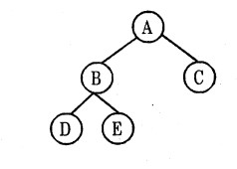
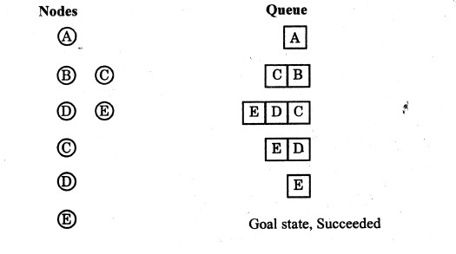
Example: Route finding problem
Task. : Find a path to reach E using Queuing function in general tree search algorithm

Slide 12
Measuring problem solving performance
The search strategy algorithms are evaluated depends on four important criteria’s. They are:
(i) Completeness : The strategy guaranteed to find a solution when there is one.
(ii) Time complexity : Time taken to run a solution
(iii) Space complexity : Memory needed to perform the search.
(iv) Optimality : If more than one way exists to derive the solution then the best one is Selected

Slide 13
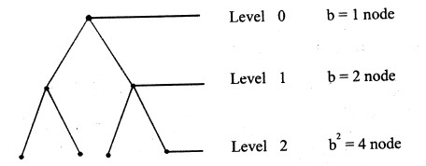
Definition of branching factor (b): The number of nodes which is connected to each of the node in the search tree. Branching factor is used to find space and time complexity of the search strategy

Slide 14
Solving Problems by Searching
The searching algorithms are divided into two categories
Uninformed Search Algorithms (Blind Search)
Informed Search Algorithms (Heuristic Search)
There are six Uninformed Search Algorithms
1. Breadth First Search
2. Uniform-cost search
3. Depth-first search
4. Depth-limited search
5. Iterative deepening depth-first search
6. Bidirectional Search

Slide 15
There are some Informed Search Algorithms
1. Generate -and-Test 2. Best First Search
Greedy Search 4. A* Search
5. AO* Search
Blind search Vs Heuristic search
Blind search | Heuristic search
The path cost from the current state to the goal state is calculated, to select the minimum path cost as the next state.
No information about the number of steps (or) path cost from current state
to goal state
Less effective in search method
More effective in search method
Problem to be solved with the given Information
Additional information can be added as assumption to solve the problem

Slide 16
HomeWork
Define the characteristics of Control Strategies.
Draw the search tree for water Jug(5,3) problem

